Slide 1


From Raw Data to Deep Learning Pipeline: Harmonizing Heterogeneous Radiological Datasets with RadHarmony
Presented by
Frank Li
Theo Dapamede
Health AI Datathon, 07.27.2026

Slide 2
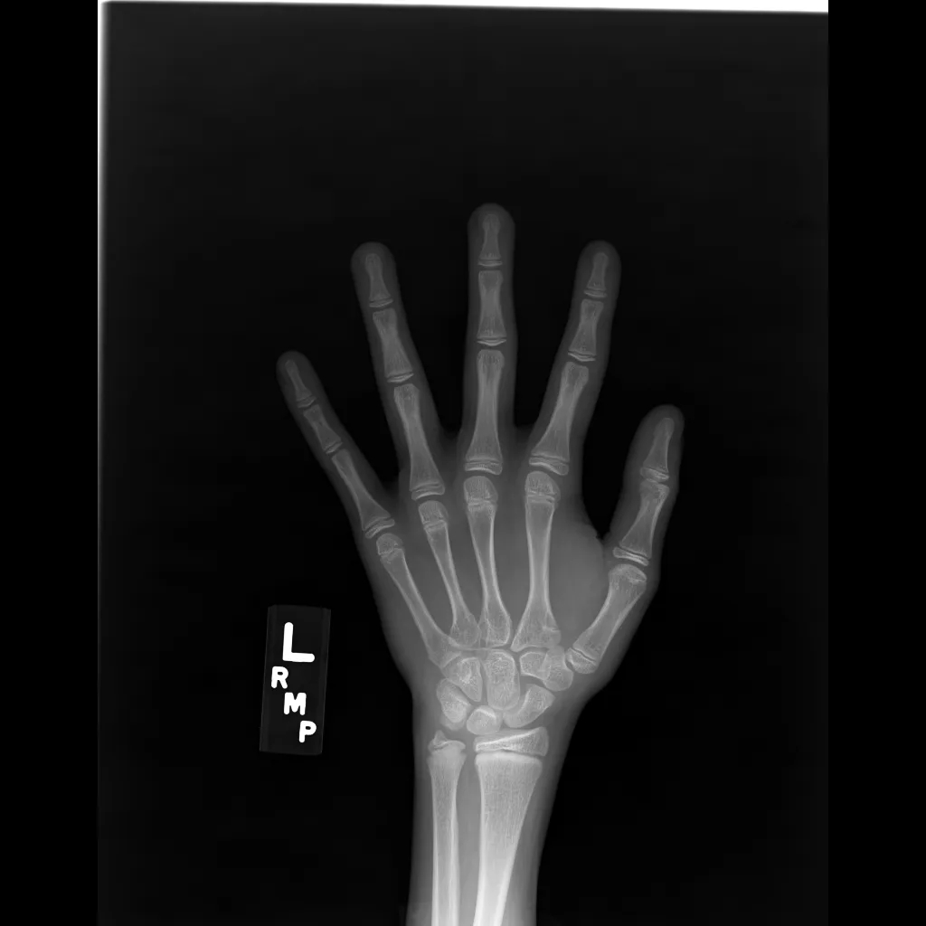
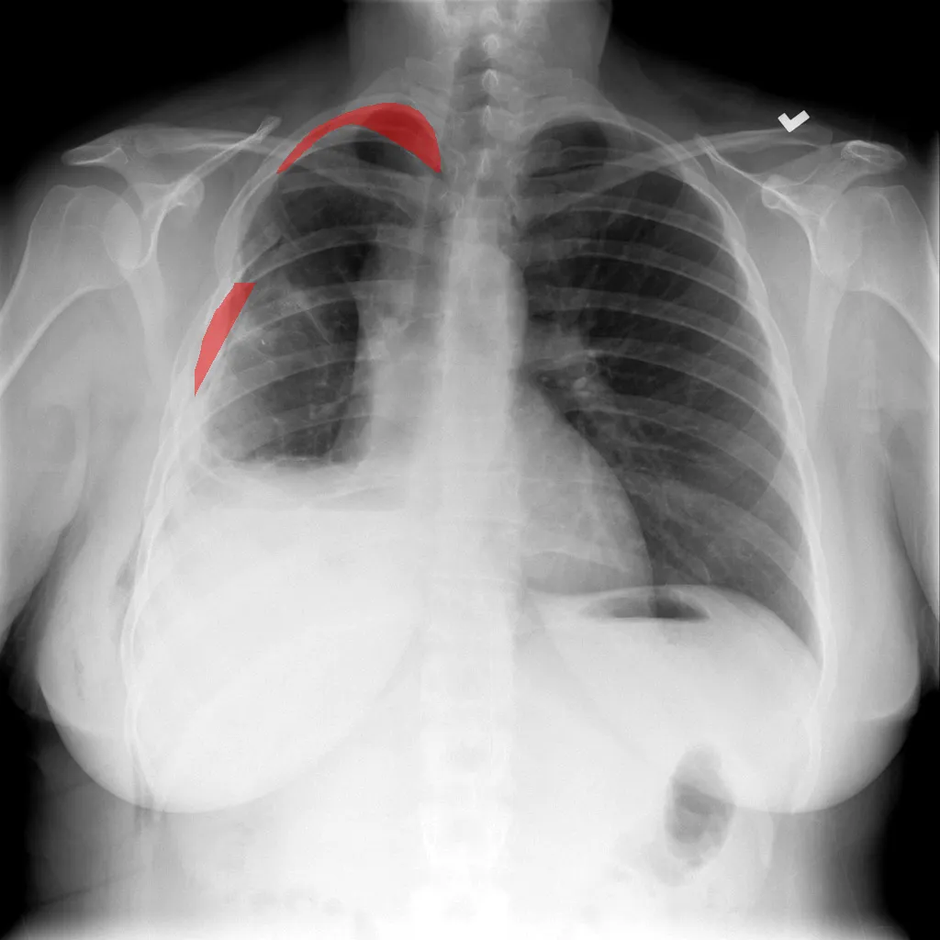
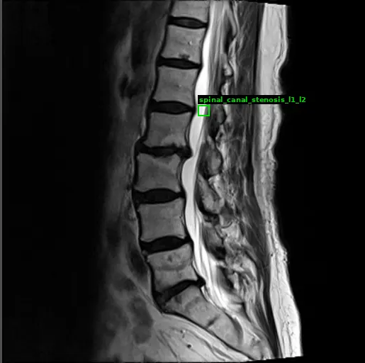
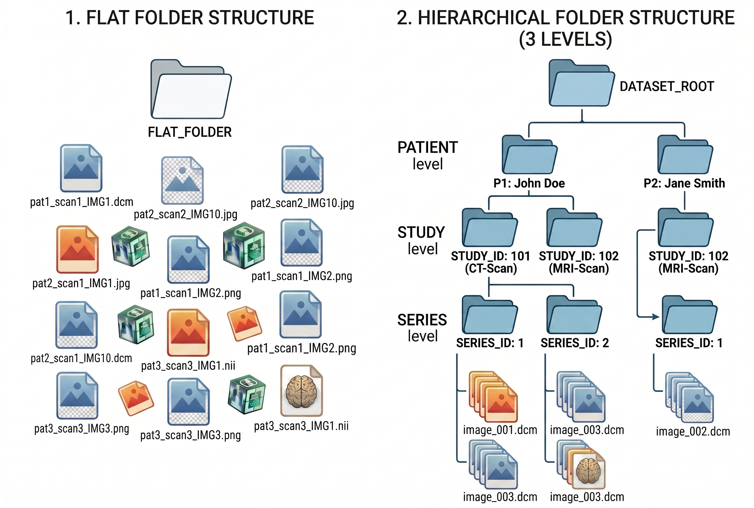
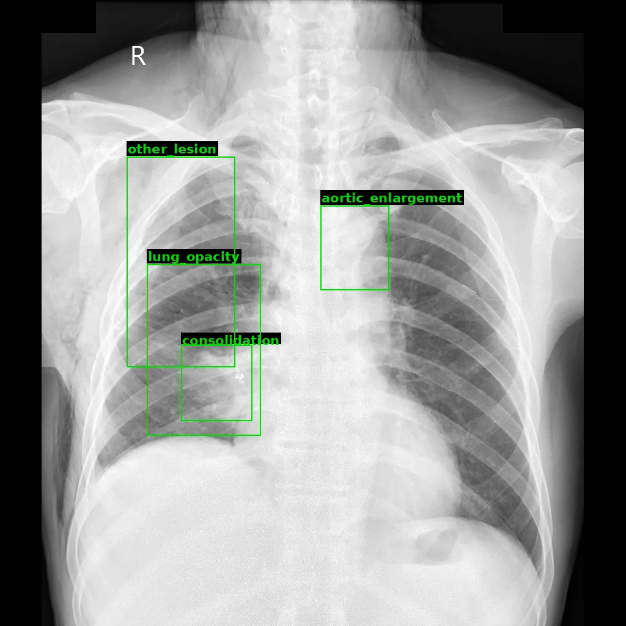
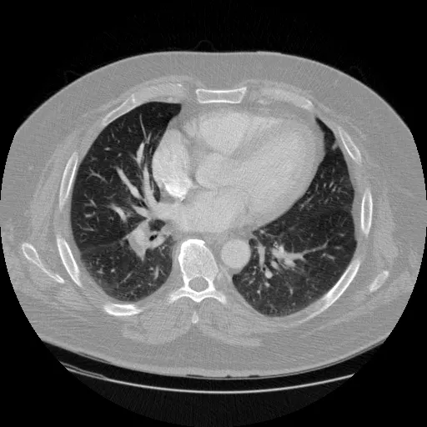
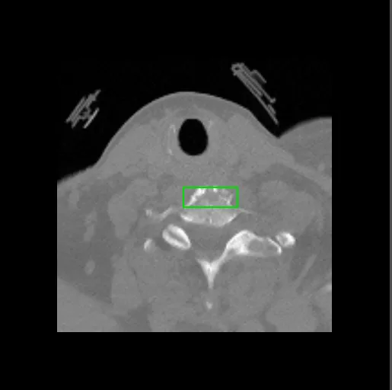
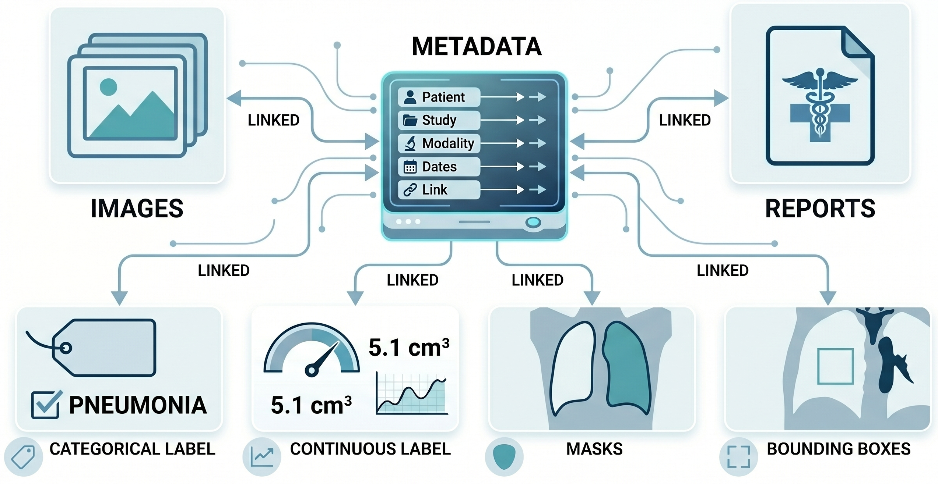
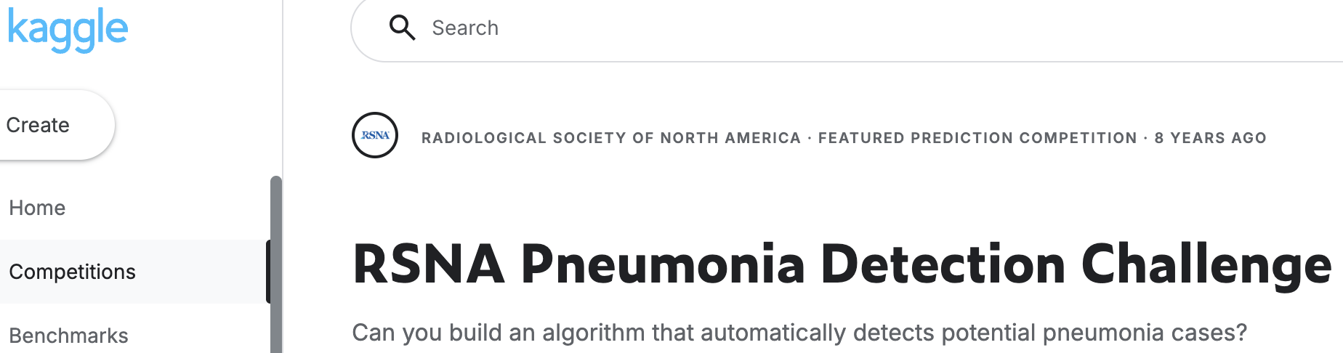

(a)
(b)
Age
Stenosis
The complexity of medical imaging data wrangling. Preparing clinical data for machine learning is hindered by severe structural fragmentation. Researchers must systematically reconcile (a) differing modalities and multi-format annotation schemas, alongside (b) highly variable file formats and folder architectures. (c) The core task of data wrangling involves establishing a metadata framework to link these heterogeneous elements together. (d) Finally, version control tracking across multiple releases of a single dataset adds further overhead to the curation process.
Pneumothorax
PE
Fracture
Multi-label
(c)
(d)

Slide 3



RadHarmony
Load datasets without dataset-specific code
24
public datasets
standardized to one schema
Open-source Python library
It encodes the domain knowledge each dataset needs
Through one unified interface, heterogeneous radiological datasets → AI-ready data
3
modalities:
X-ray · CT · MRI
5
annotation types: class, mask,
bbox, regression, report text
from radharmony.dataset import MIMICCXRDataset
from torch.utils.data import DataLoader
ds = MIMICCXRDataset(
base_image_dir=MIMIC_DIR,
output_cls=True)
loader = DataLoader(ds.get_datasets())
That's the whole code for any of 24 datasets.

Slide 4

Multi-dataset training, as easy as single
Combine heterogeneous datasets through one interface and concatenate them into a single DataLoader
MIMIC-CXR
VinDr-CXR
Unified DataLoader
ready for training
RadHarmony
SIIM-ACR
harmonize + concat

Slide 5



Unified Evaluation Pipeline
Results are comparable across studies
Plug in any model and test it with the same evaluators and the same scoring method every time so results are directly comparable.
Classification — 5 probes
linear · k-NN · prototype · SVM · fine-tune
Segmentation — 3 probes
linear · conv · UPerNet
Zero-shot
prompt-based, for vision-language model encoders
Report Generation
prompt-based, for vision-language models

Slide 6

Activity
Finish the try-it-yourself sections
Find any bugs in the package
Find any errors in the documentations:
  https://f10409.github.io/RadHarmony/index.html
Create a discussion in the GitHub repo:
  https://github.com/f10409/RadHarmony/discussions/4

Slide 7
RadHarmony Evaluators
Presented by
Frank Li, PhD
Theo Dapamede, MD, PhD
Health AI Datathon, 07.29.2026

Slide 8
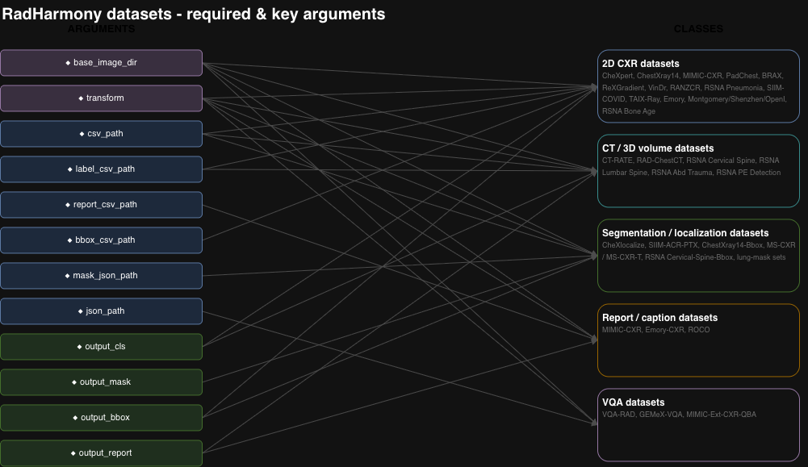

Slide 9
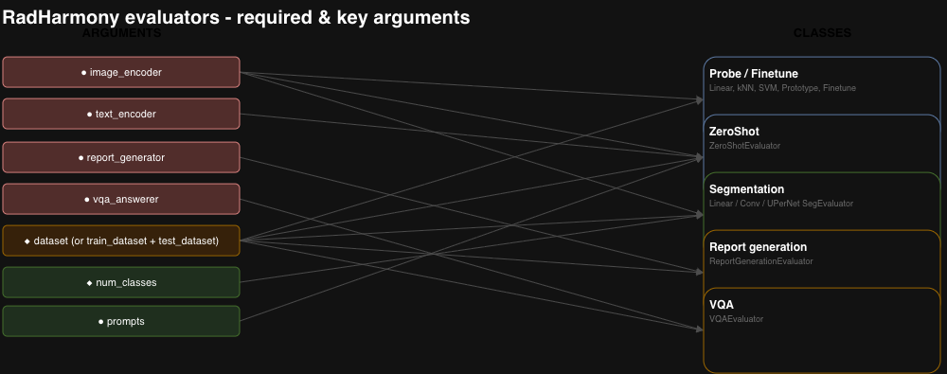

Slide 10
Image Encoder Evaluation (classification / zero-shot / segmentation)
Slot | Example
<MODEL_RECIPE> | medsiglip
<TASK> | linear probing
<EVALUATOR> | linear probe evaluator
<DATASET_CLASS> | Montgomery CXR
<IMAGE_PATH> | /mnt/efs/cxr/Montgomery-CXR/MontgomerySet/CXR_png/
<OUTPUT_FLAG> | iutput_cls=True
Shared Output Prompt:
Report metrics as mean [95% CI]. Save result tables and sample-prediction overlays as PNGs in “evaluator_outputs” folder.
Prompt Template:
Using the use-radharmony skill, run a 5-fold <TASK> with the frozen <MODEL_RECIPE> encoder on <DATASET_CLASS> at <IMAGE_PATH>, using <EVALUATOR> and <OUTPUT_FLAG>. [Shared Output Prompt]

Slide 11
Example
Using the use-radharmony skill, run a 5-fold linear probing on tuberculosis with the frozen MedSigLIP encoder on Montgomery CXR at /mnt/efs/cxr/Montgomery-CXR/MontgomerySet/CXR_png/, using LinearProbeEvaluator and set output_cls=True. Use RadHarmony-(medgemma) environment. Report metrics as mean [95% CI]. Save result tables and sample-prediction overlays as PNGs in “evaluator_outputs” folder. Run the task on CUDA0 if needed.

Slide 12
Can also try:
Different uncertainty measurement (e.g. bootstrapped CI) by providing a training data and a test data.
  Hint: training and test data need to share the same labels
Different encoders or datasets
Different probes (classification or segmentation)
  Documentation: https://f10409.github.io/RadHarmony/index.html
  Or just ask your coding agent..

Slide 13
Visual Question Answering (VQA)
Slot | Example
<MODEL_RECIPE> | medgemma
<DATASET_CLASS> | VQA-RAD
<IMAGE_PATH> | /mnt/efs/cxr/VQA-RAD/VQA_RAD Image Folder
Prompt Template:
Using the use-radharmony skill, run visual question answering with <MODEL_RECIPE> on <DATASET_CLASS> at <IMAGE_PATH> via VQAEvaluator. Report token F1 overall plus accuracy on the closed (yes/no) subset, with bootstrap CIs. [Shared Output Prompt]

Slide 14
Report Generation
Slot | Example
<MODEL_RECIPE> | medgemma
<DATASET_CLASS> | MIMIC CXR
<IMAGE_PATH> | /mnt/efs/cxr/MIMIC-CXR-V2-AWS/files/
Prompt Template:
Using the use-radharmony skill, generate <DATASET_CLASS> report with <MODEL_RECIPE> via ReportGenerationEvaluator on <IMAGE_PATH> scored with BLEU + RadGraph F1 with CIs. Sample only 50 samples for evaluation.

Slide 15
Model recipe | Returns | Classification probe | Zero-shot | Segmentation | VQA | Report gen
make_medsiglip | 4-tuple (img + text enc) | ✅ | ✅ | ✅ | – | –
make_raddino | 2-tuple (img enc only) | ✅ | ❌ | ✅ | – | –
make_biomed_clip | 4-tuple (img + text enc) | ✅ | ✅ | ✅ | – | –
make_medgemma_vqa | (transform, answerer) | – | – | – | ✅ | –
make_medgemma_generator | (transform, generator) | – | – | – | – | ✅
make_chexagent_vqa | (transform, answerer) | – | – | – | ✅ | –
make_chexagent_generator | (transform, generator) | – | – | – | – | ✅
make_maira2_generator | (transform, generator) | – | – | – | – | ✅
Dataset class | Resolved image path
MontgomeryCXRDataset | /mnt/efs/cxr/Montgomery-CXR/MontgomerySet/CXR_png/
VinDrCXRTestDataset | /mnt/efs/cxr/VinDr-CXR/1.0.0/test/
SIIMACRPTXTrainDataset | /mnt/efs/cxr/SIIM_ACR_Pneumothorax/dicom-images-train/
MIMICCXRDataset | /mnt/efs/cxr/MIMIC-CXR-V2-AWS/files/
VQARadDataset | /mnt/efs/cxr/VQA-RAD/VQA_RAD Image Folder

