Slide 1

Datathon26 CXR Datasets
07/31/2026
HITILab, Emory University

Slide 2
CXR Datasets
Dataset | Annotation types | Report | Datathon26 task(s) supported
DS1 | Multi-label findings + report | ✅ English | Classification, Report generation
DS2 | Report | ✅ English | Report generation
DS3* | Multi-label findings + bounding boxes | ❌ | Classification
DS4 | Multi-label findings + report | ✅ English | Classification, Report generation
DS5 | Multi-label findings + report | ⚠️ Spanish | Classification, Report generation
DS6 | Binary label + mask | ❌ | Classification, Segmentation
*3-radiologist majority vote

Slide 3

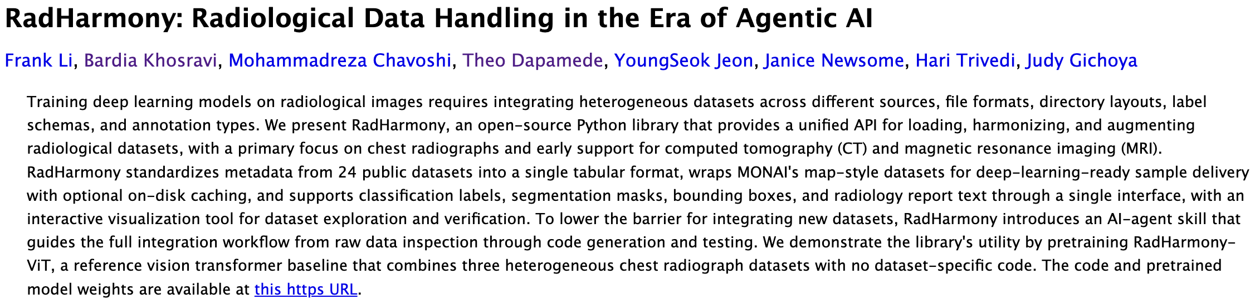
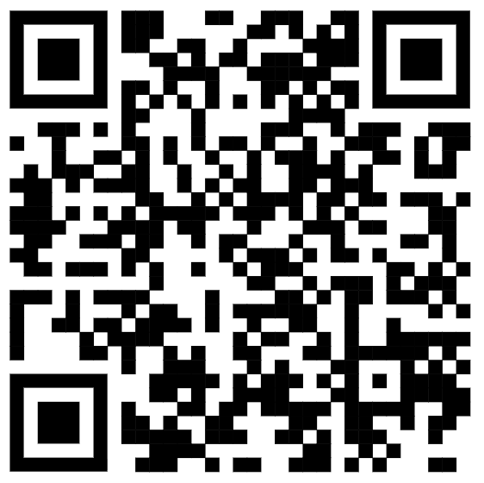
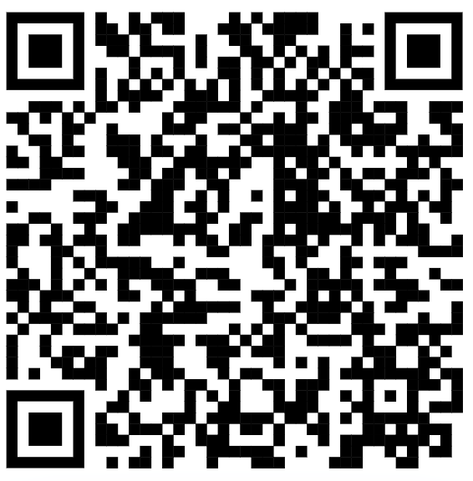
https://arxiv.org/abs/2607.27235
Preprint
Documentation

